Slide 1

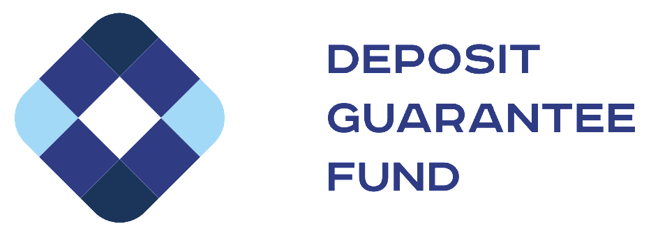
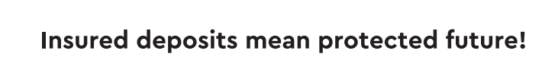
DGF SALES PROCESS

Slide 2

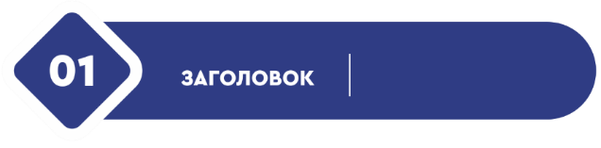

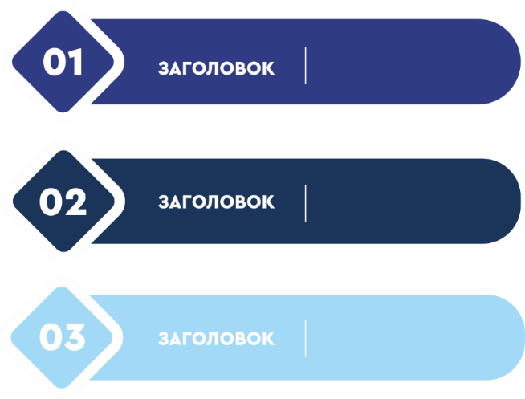
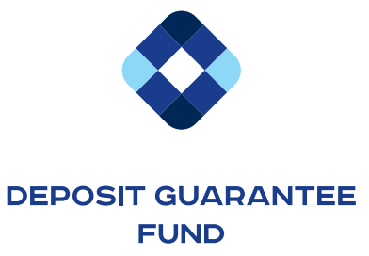


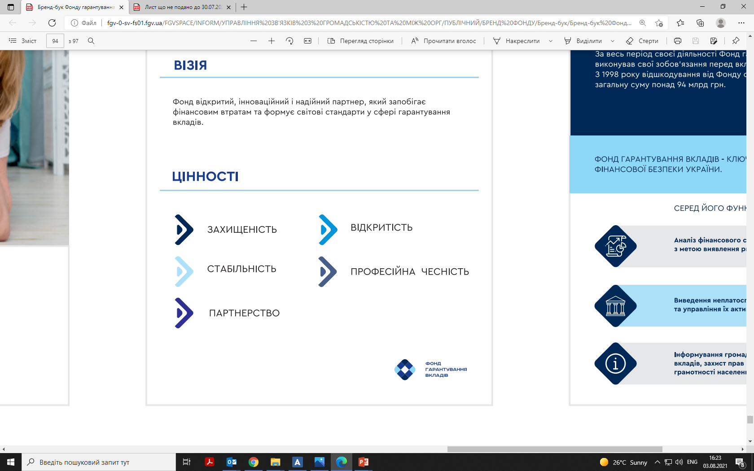
SALE OF FAILED BANKS’ ASSETS – IS THE MAIN WAY TO OBTAINE PROCEEDS FOR THE SATISFACTION OF CREDITORS’ CLAIMS
1
3
DEPOSIT GUARANTEE FUND
SALES PLATFORMS
INVESTOR, ASSETS BUYER
13 electronic marketplaces simultaneously have access to auctions at Prozorro.Sale
IT solution for auctions organizing
potential buyer gets access through ANY of the 13 marketplaces online
extensive accessibility
reliable access to sales -protection from site hacking, DDoS-attacks and other manipulations
manages assets
puts assets on sale

Slide 3



DGF USES TWO TYPES OF AUCTIONS TO SELL ASSETS
Starting price of an asset at the first auction is gross book value - aggregated amount of principal and accrued interest or independent appraiser assessment (the higher between these two)
English auction
Dutch auction
Dutch auction
ascending dynamic auction
higher bidder wins
gradual price decline
-10% between auctions
descending clock auction
every 5 mins the price decreases by 1%
sealed bids
rounds
rounds
2
3
4
1
100%
100%
1
2
90%
price is reduced from 100% to 70%
within one day,
next auction: from 100% to 50%
within one day
next auction: from 100% to 80%
within one day
next auction: from 100% to 90%
within one day
3
80%
4
70%
30%
5
60%
6
50%
ASSET
ASSET
40%
50%
7
8
30%
9
20%
10
10%
20%
10%

Slide 4

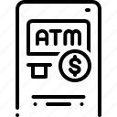










POOLS OF ASSETS
Assets which have not been sold individually are put for sale in pools (portfolios)
POOLS
Fixed assets
Loans to individuals:
mortgages, car loans, unsecured
Individual sales
ASSET
Real estate and land plots
Loans to legal entities, financial and industrial groups
10%
price is reduced
from 10%
Pools
4%
0,8%

